Slide 1
Operating System
An operating system acts as an intermediary between the user of a computer and computer hardware.
The purpose of an operating system is to provide an environment in which a user can execute programs conveniently and efficiently.
An operating system is software that manages computer hardware.
The hardware must provide appropriate mechanisms to ensure the correct operation of the computer system and to prevent user programs from interfering with the proper operation of the system.
A more common definition is that the operating system is the one program running at all times on the computer (usually called the kernel), with all else being application programs.

Slide 2
Evolution of Operating Systems
Operating Systems have evolved in past years.
It went through several changes before getting its original form.
These changes in the operating system are known as the evolution of operating systems.
The evolution of the operating system went through four generations.
Let us see these generations in detail:
First Generation
Second Generation
Third Generation
Fourth Generation
Fifth generation

Slide 3
Evolution/History of O.S
1950s, computers were limited to running one program at a time like a calculator,
but later in the following decades, computers began to include more and more software programs, sometimes called libraries, that formed the basis for today’s operating systems.
1956 -The first Operating System (GM-NAA-I/O)was created by General Motors to run a single IBM mainframe computer, its name was the IBM 704.
IBM was the first computer manufacturer to develop operating systems and distribute them in its computers in the 1960s.

Slide 4
CONTI ..
Mid-1960s -Unix was developed in the by the Massachusetts Institute of
Technology( MIT),, AT&T Bell Labs, and General Electric as a joint effort. Initially.
it was named MULTICS, which stands for Multiplexed Operating and Computing System.
FreeBSD is also a popular UNIX derivative, originating from the BSD project at Berkeley.
All modern Macintosh computers run a modified version of FreeBSD(OS X).

Slide 5
History of Operating System
Generation | Year | Electronic device used | Types of OS Devices
First | 1945-55 | Vacuum Tubes | Plug Boards
Second | 1955-65 | Transistors | Batch operating Systems/ foundation for multitasking.
Third | 1965-80 | Integrated Circuits(IC) | Multiprogramming and multitasking scheduling algorithms ( FCFS, SJF, LJF, etc)
Fourth | Since 1980 | Large Scale Integration | PC, time-shared operating systems

Slide 6
Functions of Operating System
The functions of Operating System are:
Process Management
Memory Management
File Management
Device Management
Secondary storage Management
Security
Coordination between other software and users
Networking
Job Accounting
Error detecting aids

Slide 7
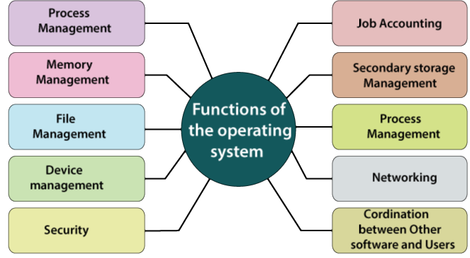

Slide 8
Functions of Operating Systems
Processor Management: It allocates the processor to a process and then de-allocates the processor when it is no longer required or the job is done.
It includes various tasks like scheduling and termination of the process.
It is done with the help of CPU Scheduling algorithms.
Memory Management:
It keeps track of the primary memory,
like what part of it is in use by whom, or what part is not in use, etc. and
It also allocates the memory when a process or program requests it.
File Management: It allocates and de-allocates the resources and also decides who gets the resource.
Device Management: The operating system keeps track of all the devices. So, it is also called the Input/Output controller that decides which process gets the device, when, and for how much time.
Job Accounting: It keeps track of time and resources used by various jobs or users.
.

Slide 9
Characteristics/ features of Operating Systems
Control on System Performance: It records the delays between the request for a service and the system.
Security: It prevents unauthorized access to programs and data using passwords or some kind of protection technique.
Efficiency: An OS allows the computer system resources to be used efficiently.
Ability to Evolve: An OS should be constructed in such a way as to permit the effective development, testing, and introduction of new system functions at the same time without interfering with service.
Throughput: An OS should be constructed so that It can give maximum throughput
(Number of tasks per unit time).

Slide 10
Functionalities of Operating System
Resource Management:
When parallel accessing happens in the OS means when multiple users are accessing the system the OS works as Resource Manager,
Its responsibility is to provide hardware to the user.
It decreases the load in the system.
Storage Management:
The file system mechanism used for the management of the storage.
All the data is stored in various tracks of Hard disks that are all managed by the storage manager.
It included Hard Disk.

Slide 11
Functionalities of Operating System
Memory Management:
Refers to the management of primary memory.
The operating system has to keep track of how much memory has been used and by whom.
It has to decide which process needs memory space and how much.
OS also has to allocate and deallocate the memory space.
Security/Privacy Management:
Privacy is also provided by the Operating system using passwords so that unauthorized applications can’t access programs or data.
For example, Windows uses authentication to prevent unauthorized access to data.

Slide 12
Components of an Operating Systems
There are two basic components of an Operating System.
Shell
Kernel
Shell
Shell is the outermost layer of, O.S.
The main task of the Shell is the management of interaction between the User and OS.
it interprets input for the OS and handles the output from the OS.
It works as a way of communication between the User and the OS.
Kernel
The kernel is one of the core components of the Operating System.
The rest of the components depends on Kernel for the supply of the important services that are provided by the Operating System.
The kernel is the primary interface between the Operating system and Hardware.

Slide 13
Functions of Kernel
The following functions are to be performed by the Kernel.
It helps in controlling the System Calls.
It helps in I/O Management.
It helps in the management of applications, memory, etc.
Types of Kernel
There are four types of Kernel that are mentioned below.
Monolithic-kernel
Micro-kernel
Hybrid Kernel
Exo-kernel

Slide 14
Difference Between 32-Bit and 64-Bit Operating Systems
32-Bit Operating System | 64-Bit Operating System
32-Bit OS is required for running of 32-Bit Processors, as they are not capable of running on 64-bit processors. | 64-Bit Processors can run on any of the Operating Systems, like 32-Bit OS or 64-Bit OS.
32-Bit OS gives a low efficient performance. | 64-Bit Operating System provides highly efficient Performance.
Less amount of data is managed in 32-Bit Operating System as compared to 64-Bit Os. | A large amount of data can be stored in 64-Bit Operating System.
32-Bit Operating System can address 2^32 bytes of RAM. | 64-Bit Operating System can address 2^64 bytes of RAM.

Slide 15
Advantages of Operating System
It helps in managing the data present in the device i.e. Memory Management.
It helps in making the best use of computer hardware.
It helps in maintaining the security of the device.
It helps different applications in running them efficiently.

Slide 16
Disadvantages of Operating System
Operating Systems can be difficult for someone to use.
Some OS are expensive and they require heavy maintenance.
Operating Systems can come under threat if used by hackers.

Slide 17
Why are Operating Systems Used?
Operating System is used as a communication channel between the Computer hardware and the user.
It works as an intermediate between System Hardware and End-User.
Operating System handles the following responsibilities:
It controls all the computer resources.
It provides valuable services to user programs.
It coordinates the execution of user programs.
It provides an interface (virtual machine) to the user.
It hides the complexity of software.
It supports multiple execution modes.
It monitors the execution of user programs to prevent errors.

